Slide 1
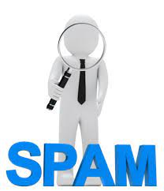
Spam review detection using linguistic and behavioural methods Batch No:18A10 G.Chandana - 18251A1210 C.Rakshitha - 18251A1235 J.Sri Harshini - 18251A1242 M.Deekshitha - 18251A1252 Guide: Ch.Sravanthi(Assistant professor)

Slide 2
Problem Statement
Consequently,manufacturers and sellers are extremely concerned with customer reviews.To gain profits or fame,spam reviews are written to promote or demote targeted products or services.
This practice is known as review spamming.

Slide 3
Paper 1:
Title :Spam Review Detection Using the Linguistic and Spammer Behavioral Methods
Author : NAVEED HUSSAIN, HAMID TURAB MIRZA , IBRAR HUSSAIN , FAIZA IQBAL , AND IMRAN MEMON
Year : 2020

Slide 4
About..
•Past and Recent Studies of SRD Using Supervised and Unsupervised Techniques.
1.Clustering(Existing Analysis)
2.Text Mining Model –Time Series Feature
• Spam Review Detection (SRD) using Spammer Behavioral Method Analysis
•Spam Review Detection (SRD) using
Linguistic Method Analysis

Slide 5
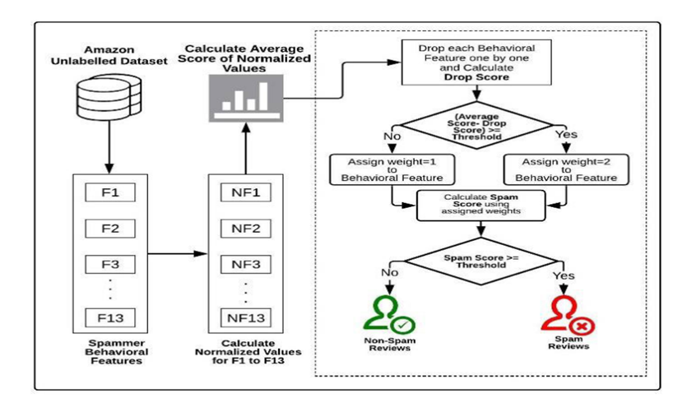
Behavioral Method:

Slide 6
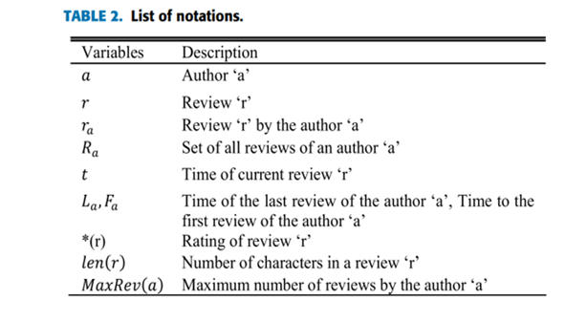
Considering….

Slide 7
Behavioral Features:
•CONTENT SIMILARITY
•MAXIMUM NUMBER OF REVIEWS
•REVIEW BURSTINESS
•ACTIVITY WINDOW
•REVIEW COUNT
•THE RATIO OF POSITIVE REVIEWS
•THE RATIO OF NEGATIVE REVIEWS
•THE RATIO OF FIRST REVIEWS
•REVIEW OF A SINGLE PRODUCT
•RATING DEVIATION
•REVIEW LENGTH
•EXTREME RATING
•THE RATIO OF CAPITAL LETTERS

Slide 8
Linguistic Method:
•Dataset
•Pre-processing
•Transformation
•Feature Selection
•Classification Methods
NAÏVE BAYES
Logistic Regression
Support Vector Machine
Random Forest

Slide 9
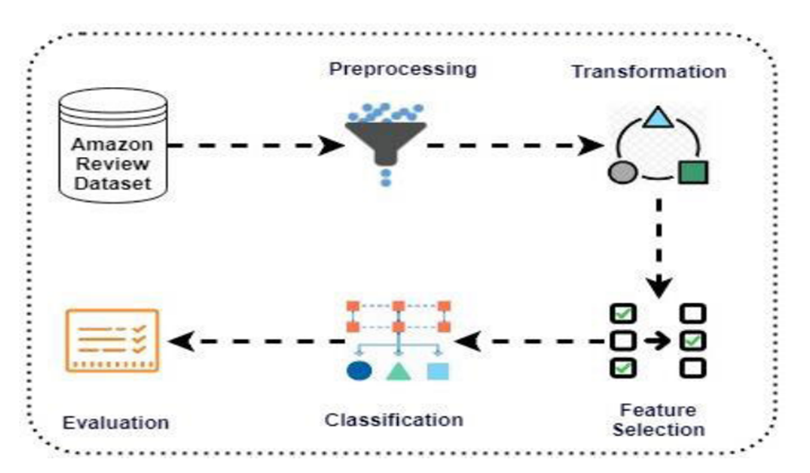

Slide 10
TITLE : Learning to detect deceptive opinion spam : A Survey
AUTHOR :Y. Ren and D. Ji
YEAR : 2019

Slide 11
SUMMARY:
Summarize the existing dataset resources and their construction methods.
Traditional Statistical Method

Slide 12
FEATURE ENGINEERING:
-> TEXT FEATURES:
BAG OF WORD
META-DATA FEATURES
SEMATIC
-> BEHAVIOR FEATURES:
MAXIMUM CONTENT SIMILARITY(fCS)
Cosine similarity is used to measure the content similarity
MAXIMUM NUMBER OF REVIEWS:(fMNR)
Threshold value is greater than 5 reviews per day
EXTREME RATING BEHAVIOR: either too high too low is consider as spam

Slide 13
REVIEW LENGTH:
On average the length of review is 200 words but for a spam it is considered as more than average
METHODS:
TRADITIONAL STATISTICAL METHODS:
1)SUPERVISED LEARNING
SVM
LOGISTIC REGRESSION
NAIVE BAYES
2)UNSUPERVISED LEARNING

Slide 14
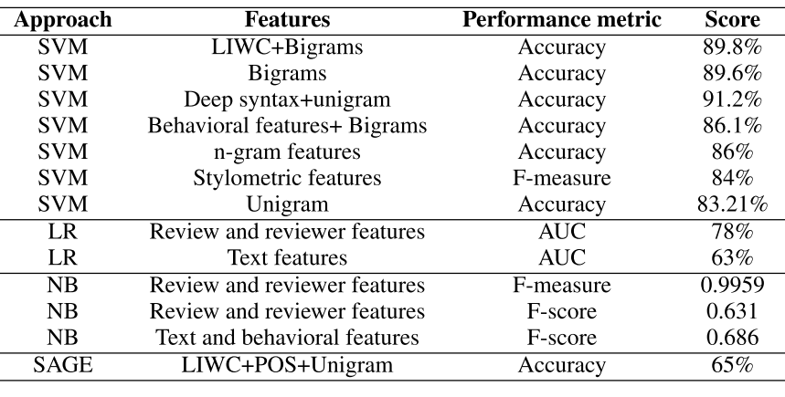

Slide 15
TITLE : Spam Review Detection Using Deep Learning
AUTHOR :G.M.Shahariar, Swapnil Biswas &
Faiza Omar
YEAR : 2020

Slide 16
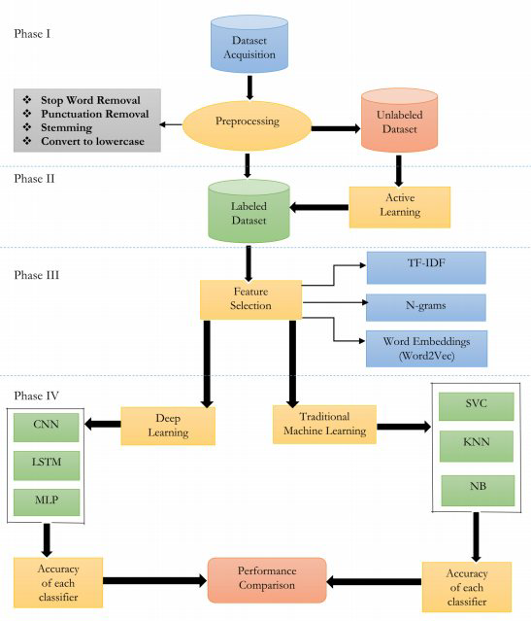

Slide 17
Method Train Test Ratio Accuracy
CNN 90:10 91.583%
LSTM 70:30 94.565%
MLP 70:30 92.25%

Slide 18
Existing System
1
1.Web Spam or email spam detection
Draw Backs:
No implementation for Review Spam

Slide 19
The proposed approach incorporated linguistic features and a number of behavioural features for developing the spam review detection model.
Proposed models

Slide 20
Objectives:
1.The main objective of our project is to predict whether the review is spam or not.
2.To display the percentage of spam content called as spam score in the form of pie chart.

Slide 21
Thank you

